Slide 1
Accumulation as an Objective for Charitable Foundations
Peter Walls
Charity Law Conference April 2019

Slide 2
Modernising the Charities Act 2005: Discussion Document Te Tari Taiwhenua | Internal Affairs, February 2019

Slide 3
operating entity | associated foundation (registered charitable trust)
Museum of New Zealand Te Papa Tongarewa* | Te Papa Foundation
New Zealand Symphony Orchestra* | NZSO Foundation
Auckland Philharmonia Trust | Auckland Philharmonia Foundation
Christchurch Symphony Trust | CSO Foundation Trust
Wellington Regional Orchestra Foundation Incorporated (trading as Orchestra Wellington) | The Orchestra Wellington Foundation Trust Board [established 2018]
The Royal New Zealand Ballet | The Ballet Foundation of New Zealand Trust
New Zealand Opera Ltd (trading as NZ Opera) | New Zealand Opera Foundation Trust
Chamber Music New Zealand Trust* | Chamber Music New Zealand Foundation
New Zealand String Quartet Trust | New Zealand String Quartet Foundation
Nelson Music Festival Trust (trading as Adam Chamber Music Festival) | Nelson Music Festival Foundation
*Autonomous Crown Entity

Slide 4
Performing Arts Companies’ Revenue Streams

Slide 5
Comparison of operational costs/total equity in two Trust/Foundation pairs
Foundation 1: grants = 6% of total equity
Foundation 2: grants = 8% of total equity

Slide 6
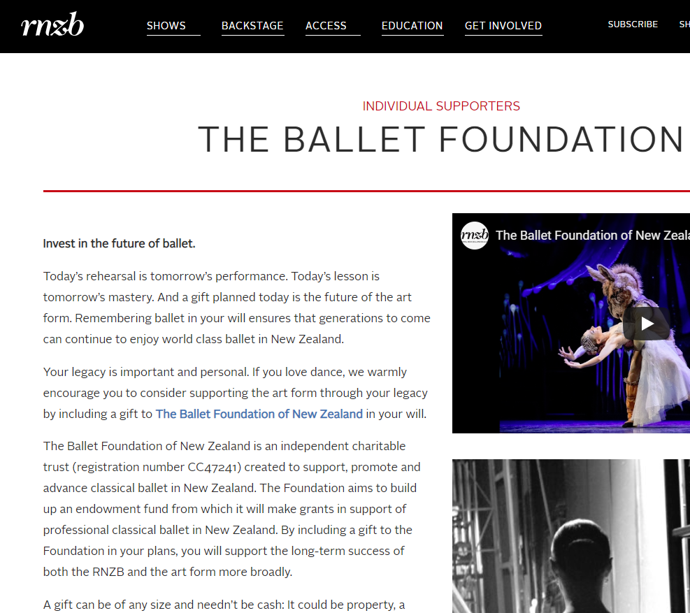

Slide 7
Equity of US and NZ Presenters compared (NZD)
Note: for NZ companies the assets represent the ‘consolidated’ assets of operating entity and foundation

